Slide 1
Gendered Pathways in Science: Exploring the Impact of Researcher Gender on Academic Success
CIS 5190 Applied Machine Learning
Deniel Shumeiko & Zed Liu
University of Pennsylvania
Notes:
Hello, My name is Deniel Shumeiko, my project Partner is Zed Liu, and today we want to share with you our Group Project that we titled as “Gendered Pathways in Science: Exploring the Impact of Researcher Gender on Academic Success”

Slide 2
01
Project Introduction
02
Data Collecting and Preprocessing
03
Exploratory Data Analysis (EDA)
CONTENTS
04
Feature Engineering
05
Modeling
06
Conclusion
Notes:
So before we dive into the core of the project, I am gonna give you an overview of our presentation. We gonna start off by introducing the motivation behind this investigation, we then gonna address one of the key contributions in this project, which is the process of data collection. Then, we going to walk you though our Statistical Analysis that guided us throughout this project. We then going to describe the feature engineering process, following by showing our modelling results, and wrapping up with the discussion and conclusion section. So, lets begin.

Slide 3
Statement, Motivations & Contributions
/01
01. Problem Statement
Predict the H-index of Human Computer Interaction (HCI) researchers using machine learning methods based on features such as citations and university rankings from Google Scholar data.
02. Research Motivation
Analyze key factors affecting academic success to guide career decisions, with a focus on assessing the impact of gender on academic achievements.
03. Main Contributions
Use a custom script to scrape Google Scholar for diverse features of HCI researchers. Implement deep neural network in H-index prediction for the first time.
Notes:
In academia, there are many ways to judge whether a given researcher has a high impact on the field with their research, and the most widely adopted metric is the H-index. In our investigation, we were curious to see whether we can build an accurate Machine Learning model to predict the H-index using the custom made features. We chose to do our project on the field of Human Computer Interaction because of its highly interdisciplinary nature, as well as a great representation of researchers based on their gender. That way, we can ensure that our training and test datasets are not biased towards one gender, thus making our finding more reliable.
As for research motivation, we wanted to see what features would have the highest predictive power of H-index, thus revealing the true driving factors behind the academic success. In order to achieve that, we decided to create our own data scraping techniques for our custom made features, making sure that we build our own original model that will have a better performance than the existing methods used for H-index predictions.

Slide 4

Data & Features We Used
H-Index
H-index
University Ranking
H-Index is the metrics we use to measure a researcher’s influence and the feature we want to predict
We incorporate university ranking and geographical location as predictive features in our analysis.
Citations
University
Ranking
Citations
Subject Ranking
Total citations, maximum citations per paper, and citations from the last five years are used as they are key indicators of a researcher's impact
We use QS Ranking in CS subject to measure the influence of the institute in HCI domain
Gender
Subject Ranking
Gender
Position/Title
Gender is one of the main feature we want to exam to see whether gender bias exists in the academic setting
The academic title of researchers is used as it reflects their professional standing and experience in the academic community.
Position/Title
Notes:
So, the feature selection is the crucial step, and we decided to incorporate not only the standard features for H-index prediction such as the citation count, max number of citations, etc. But we also incorporated the features that were not previously considered in other studies, such as the university where researchers conduct their research that we encode by the university ranking. Apart from the university ranking as a whole, we considered the subject specific ranking to make sure that specialized universities will be properly represented in the field of HCI and CS in general. We also consider the title of any individual researcher as we would naturally expect that the PhD student would have a lower H-index as compared to Professor Emeritus title. Finally, we encode the Gender of the researcher as one of the features that we want to investigate on the presence of bias. Ideally, this feature should have no implication towards the H-index of any researcher, and that is one of the goals of this investigations to find out.

Slide 5
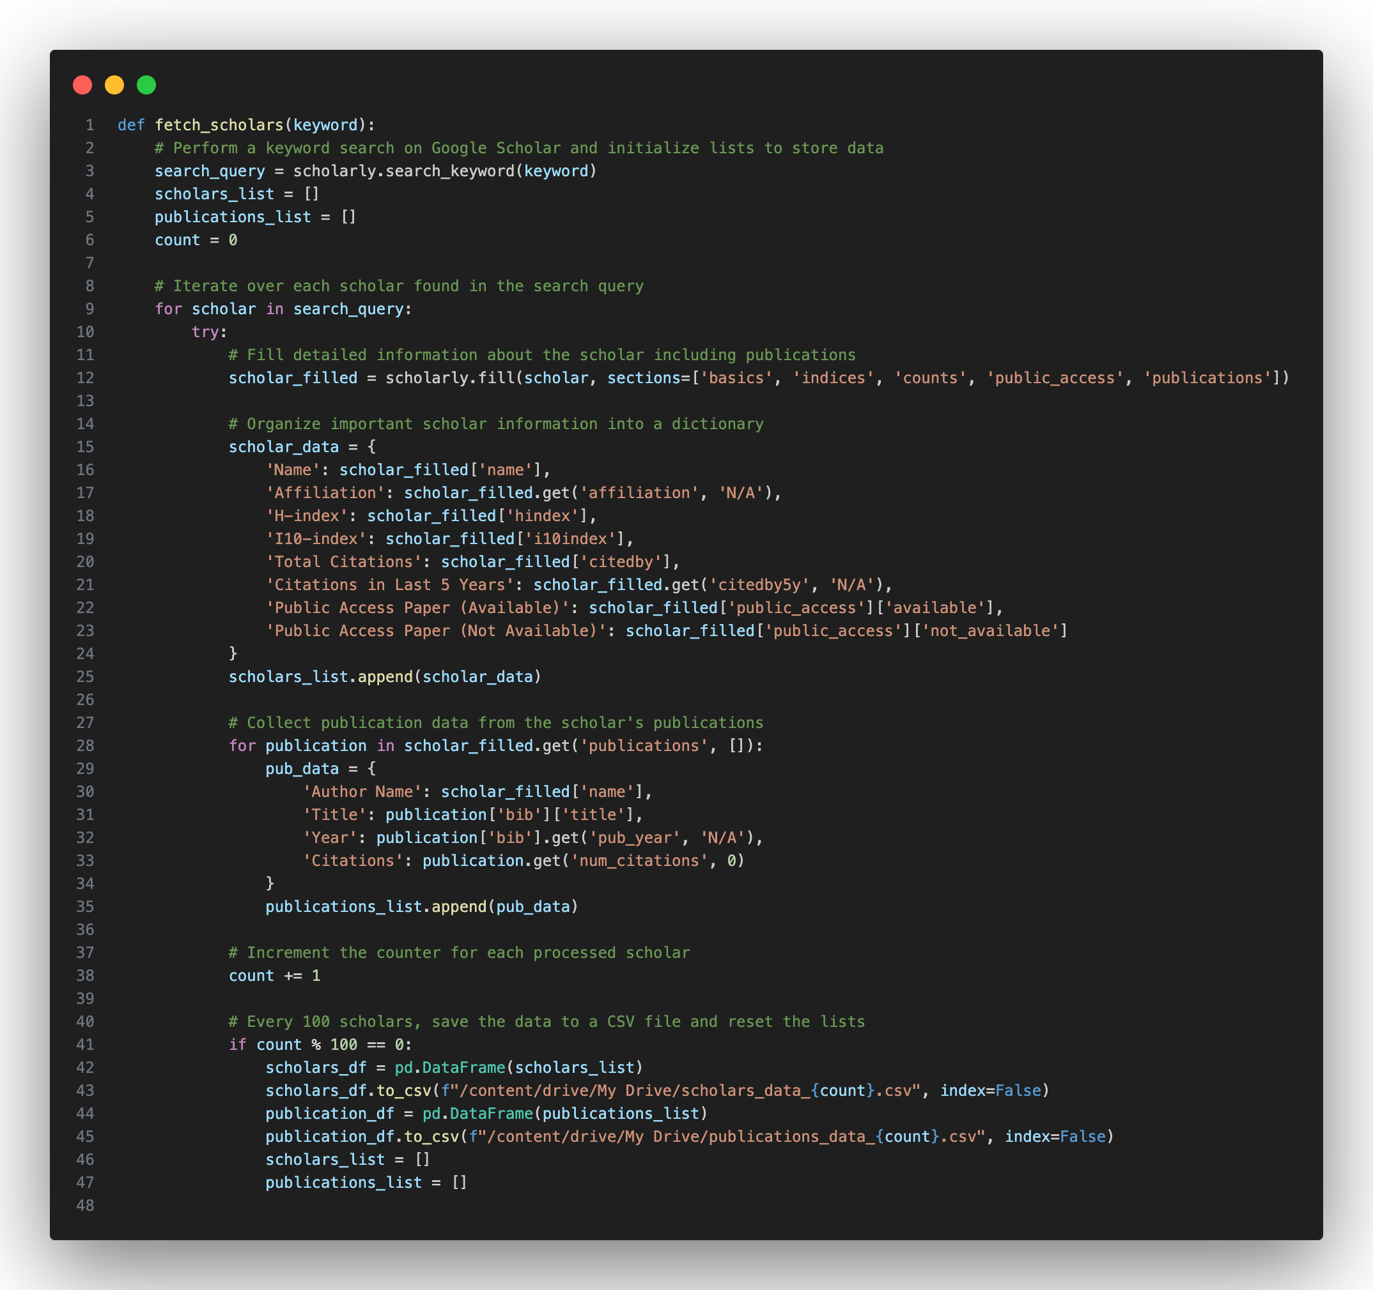
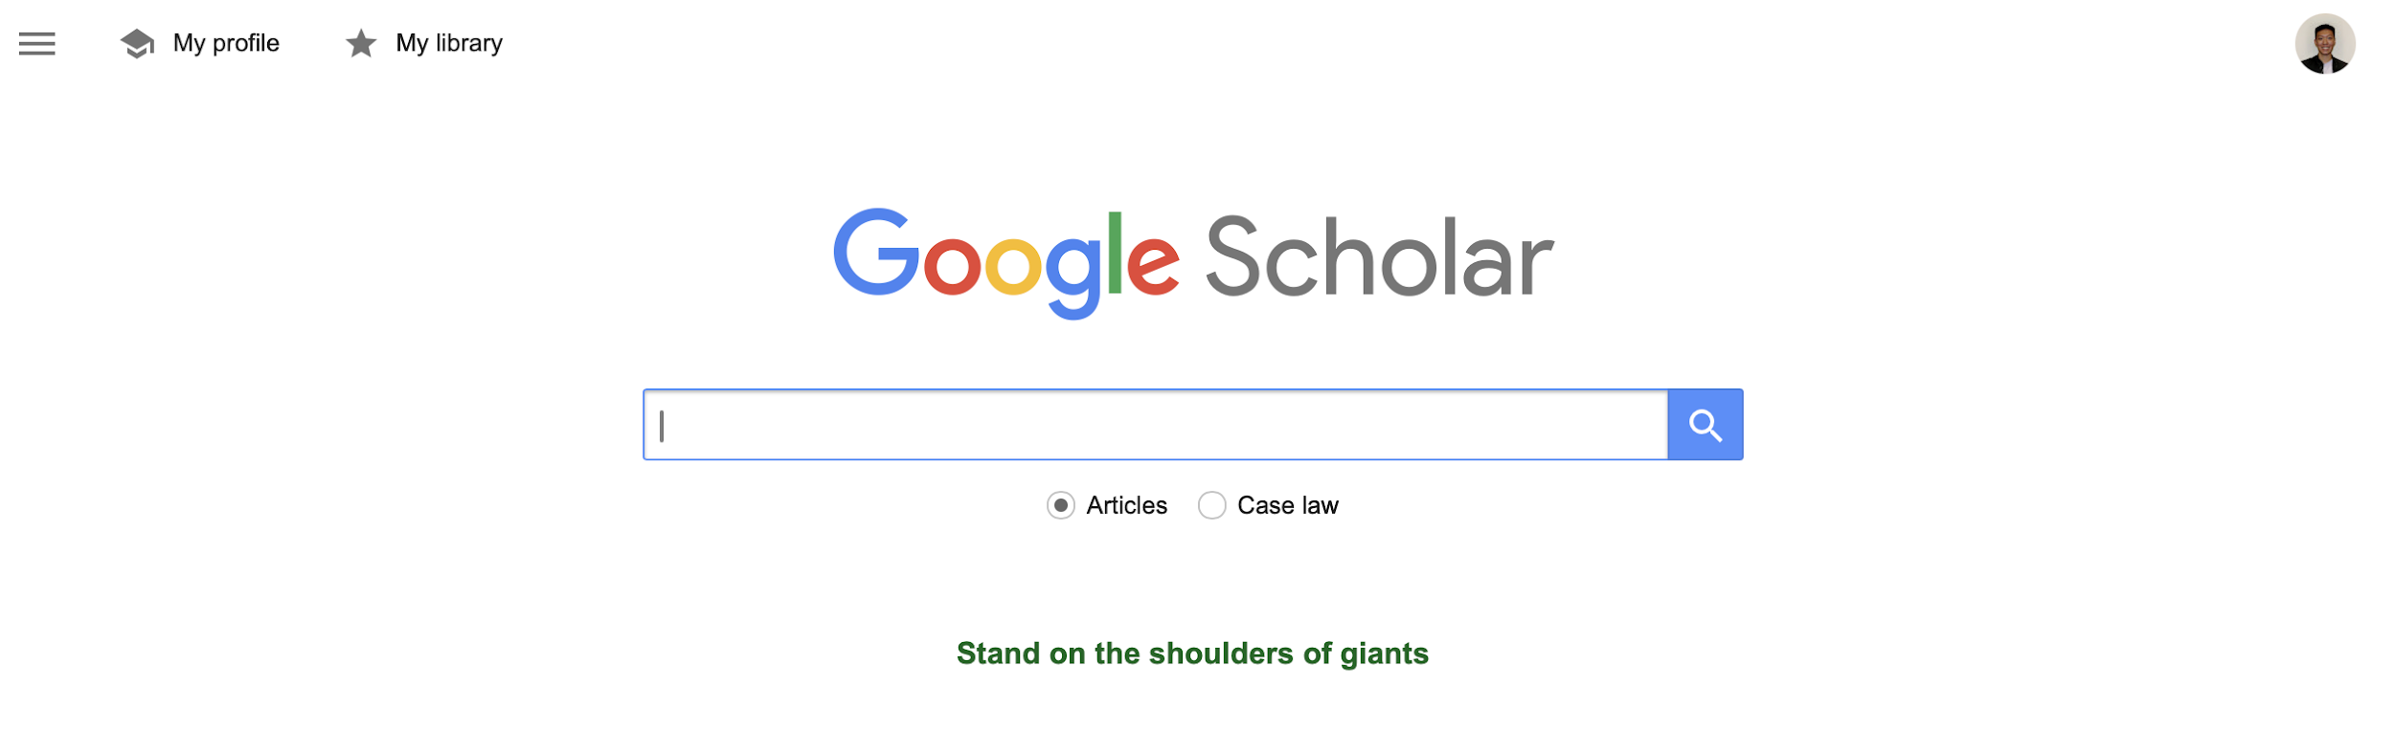
Web Scraping with `Scholarly`
/02
Using the `Scholarly` Python library, we efficiently gather information without triggering CAPTCHAs.
The custom code begins by defining a function named `fetch_scholars`, which retrieves researcher details and stores them in CSV files.
Scholars DataFrame
The Scholars DataFrame contains 8,800 entries with key information, such as Name, Affiliation, H-index, I10-Index, Total Citation, and Citations in the Last 5 years.
This dataframe stores basic information about each scholars.
Publications DataFrame
Publications DataFrame holds 518,149 records, capturing Author Name, Year, Title, and Citations.
This dataframe provides us with detailed information about the publications of each researchers.
Notes:
The manual extraction of features is not very feasible for project of this scale, and this process needed to be automated. We developed the web scraping technique by implementing the function that gathers all the features of interest using the Scholarly Python library. This allowed us to extract all the needed information without running into issues with Captchas.
Overall, we gathered an initial dataframe of 88 hundred researchers, and then we had the publication dataframe of more than half a million records. Afterwards, we created a single dataframe that has all the features of interest, and after doing final data polishing, we had over 3000 researchers to do our investigation on

Slide 6

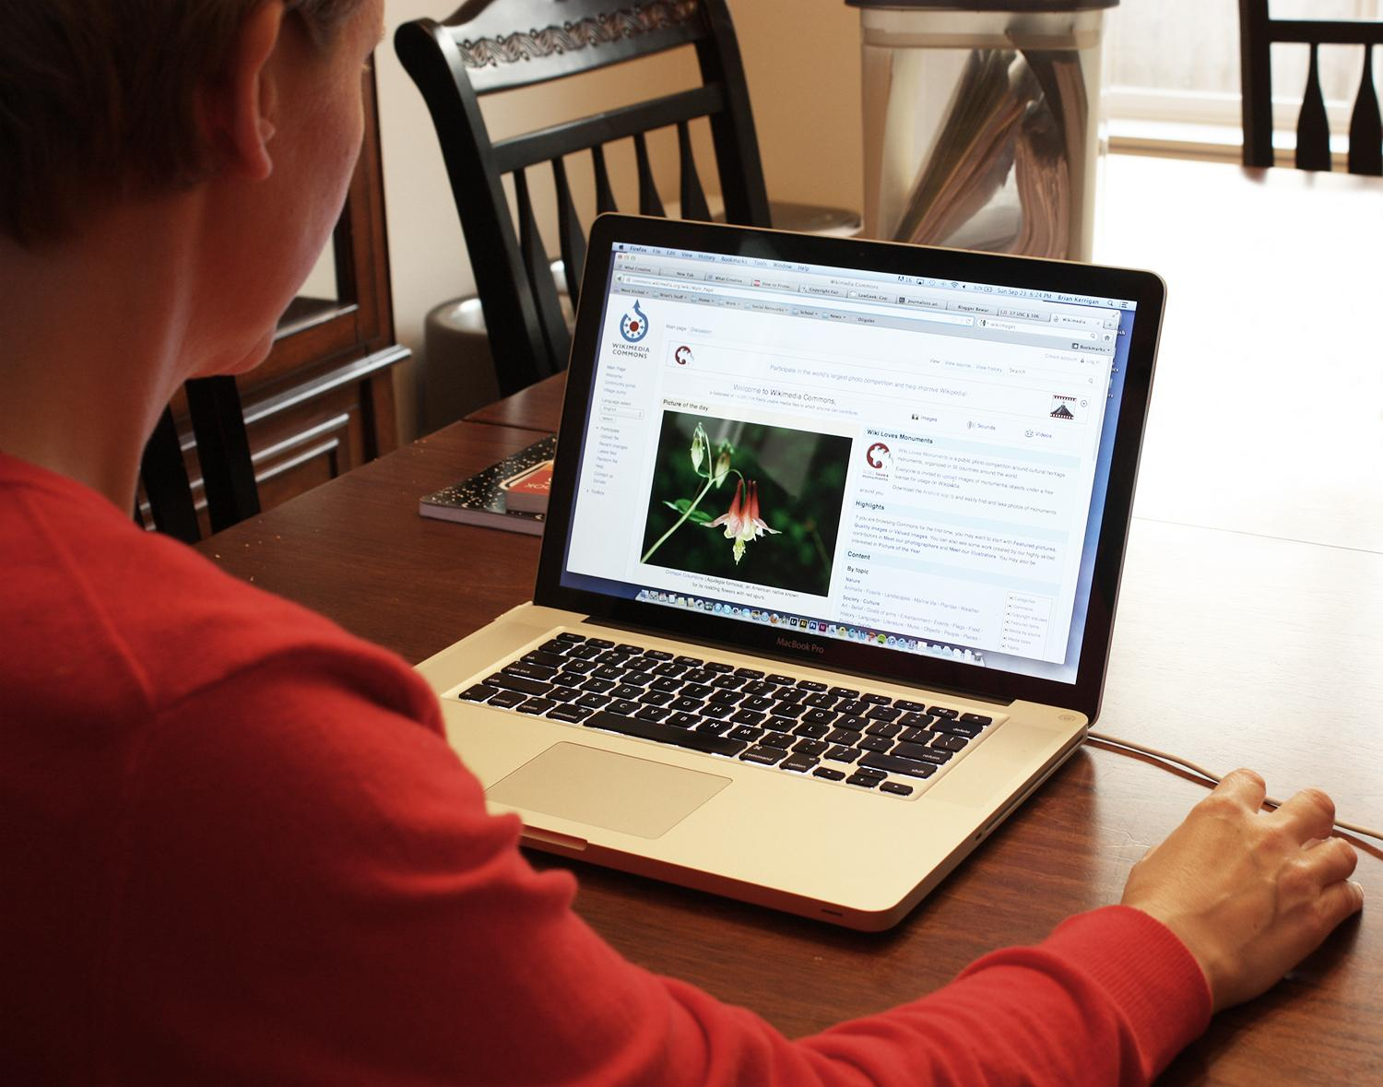


Other Data We Used
QS University Ranking
QS CS Ranking
1
To further enrich our analysis of academic influences on scholarly outputs, we integrated the QS World University Rankings into our dataset.
2
QS Ranking of CS subject is also added into our dataframe to better evaluation the CS background of each institutes.
Countries’ GDP
Gender
3
We integrated GDP rankings to examine the economic context of academic productivity
4
Since there is no database provides researchers’ gender information, we manually gathering and integrating.
Notes:
Like was mentioned before, we tried to incorporate the university and subject rankings as two of the custom made features. The natural question is: how to gather information like that? So, based on the scripts we developed, the data extraction from the QS world ranking was the most feasible and easy as compared to other rankings. In addition to being easy to automate, QS ranking is considered as one of the most reliable university rankings out there, and so we decided to choose this ranking as oppose to others. Apart from that, we incorporated the GDP metric of the countries where the universities are located to make sure to adjust for the economic background of the country as it is expected that lower GDP countries spend less on science funding.
One of the major bottle necks of our investigation, however, is the lack of gender information on google scholar, which meant that that feature had to be collected manually by extensively researching the web and manually recording the gender data of the researcher.
So, overall …

Slide 7
Data Loading & Preprocessing Pipeline
The final dataframe has 3453 rows × 17 columns, which can satisfy the requirements of the project manual and provide enough information for machine learning modeling
Data merging
Integrate and merge different dataframes using a standard foreign keys: the name of each researcher or affiliated university.
Data Cleaning
Drop unnecessary columns and meaningless instance. Deal with missing data using additional databases.
03
Data Acquisition
Load data from online database, local csv files or webpage.
02
01
Notes:
After conduction a full process of data collection, we managed to extract close to 3500 researchers with 17 features, two of which are gender and H-index. This dataset would have been bigger had the google scholar have all the required information for each researcher, but because some webpages did not have all of it, we had to drop those instances.
So, now, I will hand it over to Zed to talk more about the statistical aspect of our investigation.

Slide 8
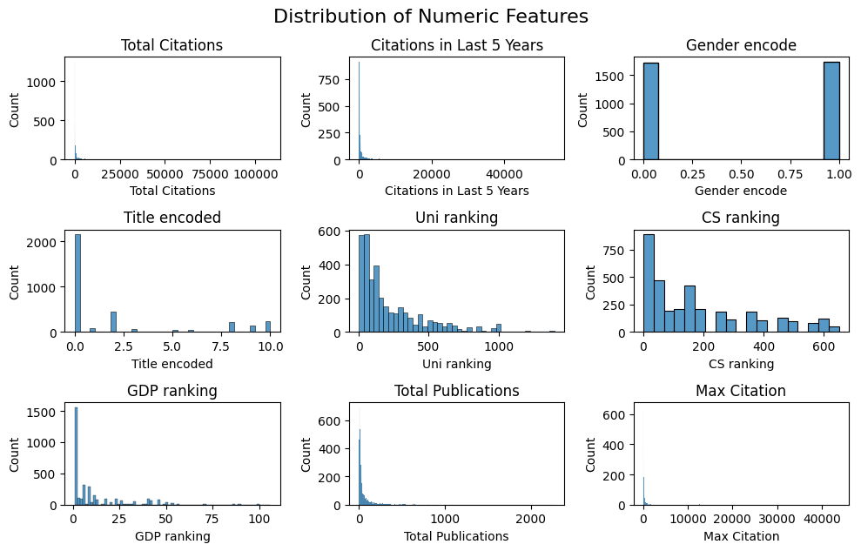
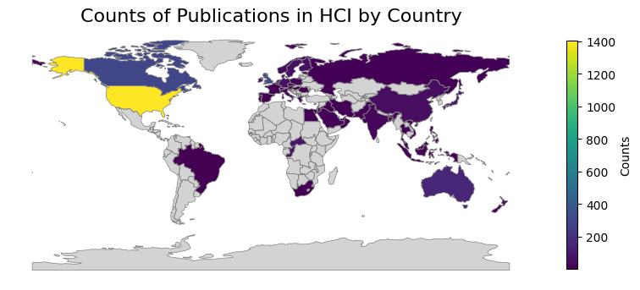
Understanding the Data Distribution
/03
Global Distribution of HCI Publications
On the heatmap we can see the distribution of HCI publications is very uneven across the world. The leading countries or regions include United States of America, United Kingdom, Canada, China, and Australia.
.
Distribution of Numeric Features
To understand the distribution of numeric features in our dataset, we generated a set of histograms. Each plot represents a distribution of unique feature. We can observe a long-tail phenomenon in most features.
Notes:
First, we used a heatmap to examine the global distribution of HCI publications. Lighter colors represent regions with a higher number of publications. The heatmap reveals an uneven distribution, with leading countries such as the United States, United Kingdom, and Canada.
The bar charts on the left illustrate the distribution of numeric features in our project. Notably, the gender distribution among HCI researchers is balanced, while other features exhibit a significant long-tail distribution.

Slide 9
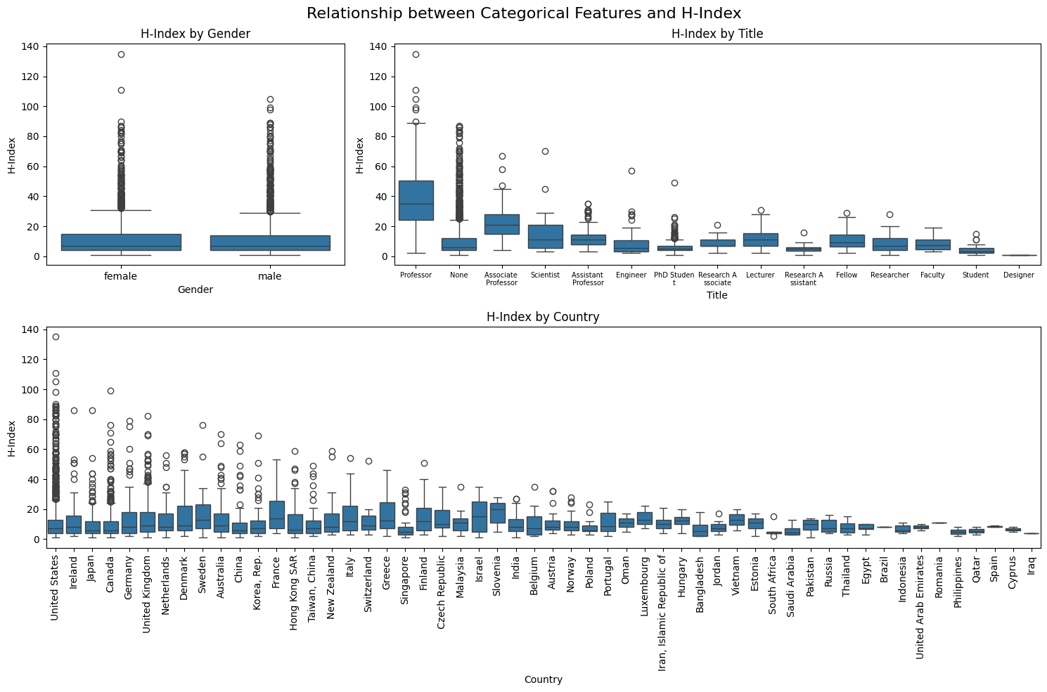
Relationship Between Features
01.
Categorical Features vs. H-Index
The figure comprises three box plots, each delving into the interplay between the H-index and categorical variables such as gender, academic/professional title, and country affiliation.
Notes:
After examining the distribution of our data,we investigated the relationship between our features and the target variable, the H-Index.
For the categorical features, we used box plots to evaluate the relationships. As shown in these three box plots, gender displays an almost identical H-Index distribution across different categories. However, features like academic title and country affiliations exhibit significant variation in H-Index among different categories.
Therefore, we can potentially assume that gender is not a very predictive feature for the H-Index, whereas academic title and country might have some predictive value.

Slide 10
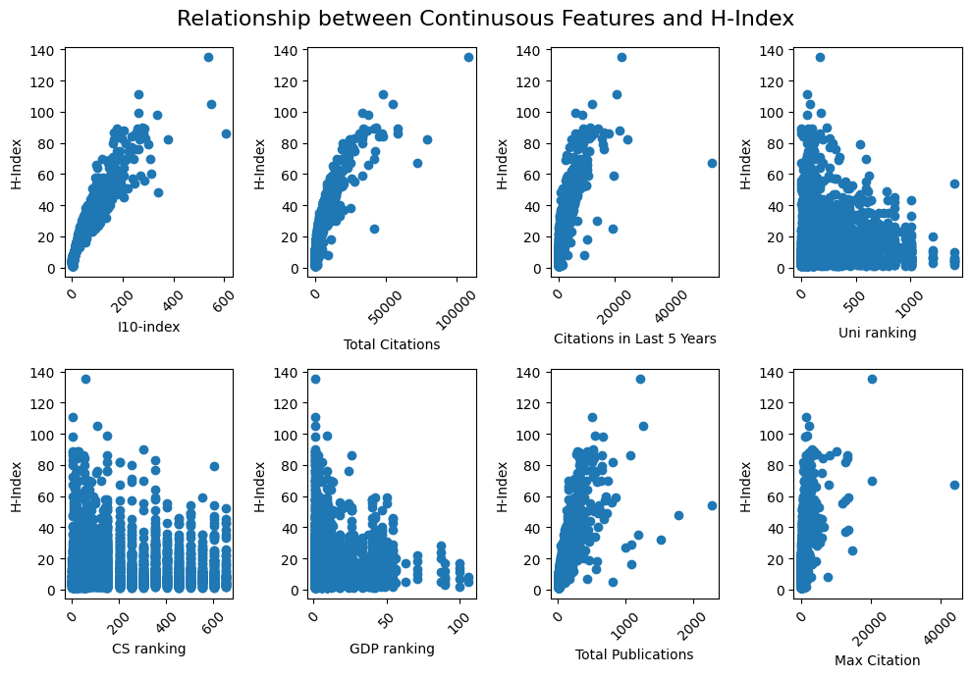
Relationship Between Features
02.
Distribution of Numeric Features
These plots illustrate how different continuous variables correlate with the H-index. While all the citation features shows a strong positive relationship with H-index, those ranking features have a negative relationship.
Notes:
For the numeric features in our dataset, we used scatter plots to examine their relationship with the H-Index.
As shown in these plots, features such as the I10-Index, total citations, citations in the last five years, total publications, and maximum citations exhibit a strong positive, and in some cases even linear, relationship with the H-Index.
On the other hand, features like university ranking, CS ranking, and GDP ranking appear to have a negative influence on the H-Index. This is understandable, as lower rankings of the affiliated university and country’s economic status may correlate with less influential research.

Slide 11
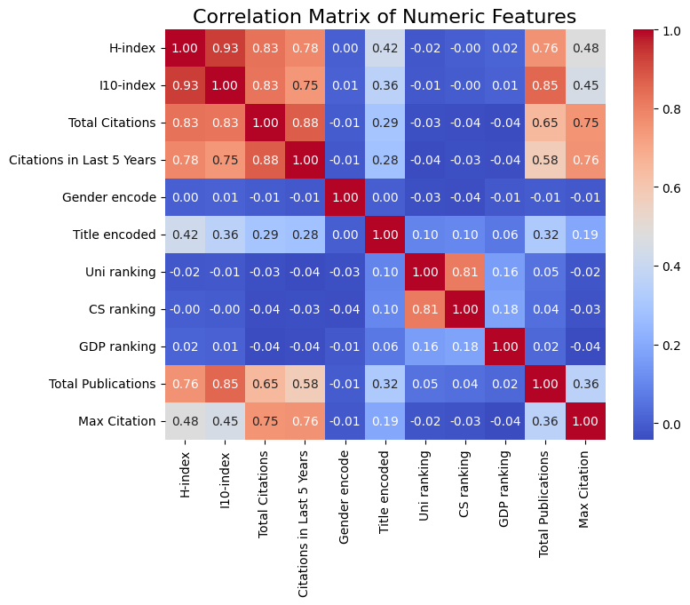
Relationship Between Features
Correlation heatmap
The strongest correlation is observed in Total Citations and H-index, while the gender is the weakest.
Since the correlation of H-index and I10-index is so high that we decide to drop I10-index during modeling.
Notes:
In the end, we implemented a correlation heatmap on our data and concluded that the strongest correlation is observed with total citations, while gender shows the weakest correlation.
Additionally, given the high correlation between the H-Index and the I10-Index, we decided to drop the I10-Index during modeling to enhance the robustness of our models.

Slide 12
Features Evaluation & Encoding
/04
Academic Title Encoding
Institutional Ranking Association
We instituted a ranking system for academic titles, assigning numerical values according to their standing. 'Professor' is rated highest, whereas titles like 'Student' receive a lower rank, reflecting their academic status.
Utilizing additional QS ranking data, we linked university names with their rankings, providing a gauge for the influence of institutional prestige on academic impact.
Country GDP
One Hot Encoding
We used the GDP ranking to encode the country. Encoding countries with GDP ranking is a logical approach, representing economic status, which correlates with research infrastructure and academic resources.
We applied one hot encoding on `gender` column, because this is a categorical column, and we do not perform any evaluation on it.
Notes:
We had to come up with the way of encoding our categorical features in a way that our models can run. For the university and subject ranking, we imported the ranking of the specific school as an integer value with 1 being the highest. That way, having a bigger number in that feature should result in a lower H-index prediction if that feature is behaving according to our intuition. Country information is encoded by the GDP metric, where country with similar GDPs will be essentially the same for the H-index prediction. Academic title encoding is a bit trickier, but we decided to rank it in the increasing order, from “student” title being the lowest, and “Professor” being the highest.
As for gender, we considered researchers that display clear and visible gender characteristics. Any instances where we were unsure about the researchers gender due to inability of finding relevant information, those instances were dropped from the dataset.

Slide 13

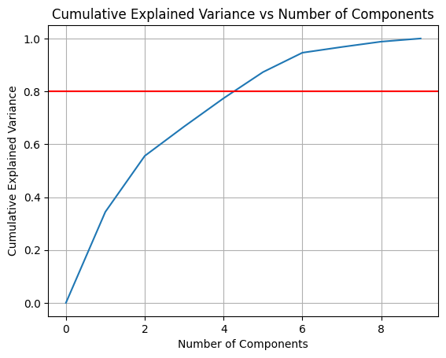
Preparation for Modeling
Create Training & Test Data
We split our datasets in 80-20 ratio. This is a highly conventional split ratio. In the interest of producing reproducible results, we set our seed = 42.
Principle Component Analysis (PCA)
We want see whether the application of PCA can help improve the performance of our model.
We need to standardize both datasets before applying PCA. The reason for standardizing is because PCA is not scale-invariant. We also used visualization to find the best component number, which is 5.
Notes:
So, having said that, we now have a complete dataset that we can run our investigation on. Given that we have a relatively large number of datapoints with respect to our feature number, we decided to split the data into 80/20 train/test datasets, which is a conventional splitting ratio. For reproducibility purpose, we fixed the seed to be 42, following the tradition from all CIS5190 coding problem sets.
Apart from that, we also wanted to see of applying PCA would help to get rid of unnecessary noise from the data and help ourselves to better generalize, so we run some models with and without application of PCA to the dataset.
So now, I will hand it over to Zed to present you our findings

Slide 14
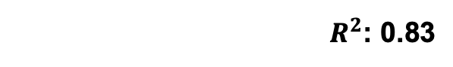

Base Line Model: Linear Regression
/05
The best linear regression model we have.
Further prove PCA is unnecessary for this model.
Without PCA
In our setting, applying PCA to the data doesn’t help with the prediction. This is because by reducing the number of features, the bias of the model significantly increase, causing a worse prediction on testing set.
With PCA
Coefficient
Analysis
Features Analysis
The analysis shows that overall and recent citations strongly boost a researcher's H-index, while a highly cited single work and worse university rankings may reduce it, with academic titles and economic factors having minor positive impacts.
Notes:
First, we built our baseline model using linear regression.
Applying PCA did not improve our prediction; it decreased the R² value from 0.83 to 0.72. This suggests that most features have predictive power, and reducing them led to information loss and an underfit model.
Feature importance analysis showed that overall citations and citations in the last five years significantly boost a researcher’s H-Index, while a lower university ranking negatively impacts it.

Slide 15
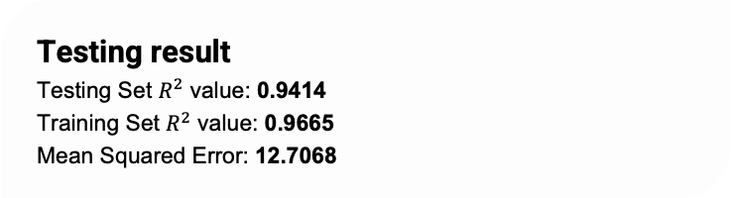
Advanced Model
AdaBoost Regressor
With Three-Fold
Cross Validation
Hyperparameter tuning using GridSearchCV
The best parameter setting is:
learning_rate: 0.1; max_depth: 7; n_estimators: 200; loss: exponantial.
Most influential factors seen from AdaBoost model's output :
Total Citations
Total Publication
Max Citation
Conclusion
The R-squared value is a relatively high, indicating a good fit to the data and strong generalization capabilities.
Notes:
Next, we trained an AdaBoost regressor, an advanced ensemble model. Using three-fold cross-validation, we found the best hyperparameters: a learning rate of 0.1, max depth of 7, 200 estimators, and the exponential loss function.
The AdaBoost regressor outperformed the linear model, achieving an R² of 0.94 on the testing set. Feature importance analysis showed that total citations, total publications, and maximum citations are the top three predictors of the H-Index.

Slide 16
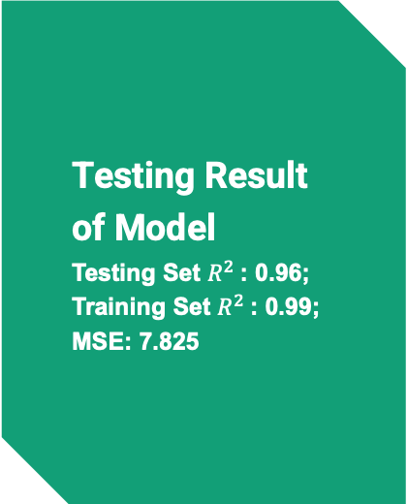
Advanced Model
Random Forest Regressor
With Three-Fold Cross Validation
Most influential factors
Hyperparameter tuning using GridSearchCV
The best parameter setting is:
bootstrap: true; max_depth: 10, min_samples_leaf': 1, 'min_samples_split': 2, 'n_estimators': 100
Conclusion:
The optimized Random Forest model is capable of providing accurate and consistent predictions, effectively balancing between underfitting and overfitting by using the specified hyperparameters
The important scores highlights the dominance of citation metrics, especially the total number of citations (0.9374), in predicting academic success, while other factors like institutional prestige, economic conditions, and personal titles play significantly lesser roles.
Notes:
Next, we trained a Random Forest regressor using three-fold cross-validation and GridSearchCV for hyperparameter tuning.
The model achieved an R² of 0.96 on the testing set and 0.99 on the training set, with an MSE of 7.825.
The optimized Random Forest model provides accurate and consistent predictions, balancing underfitting and overfitting effectively. The most influential factor is the total number of citations, while institutional prestige, economic conditions, and personal titles have lesser influence.

Slide 17
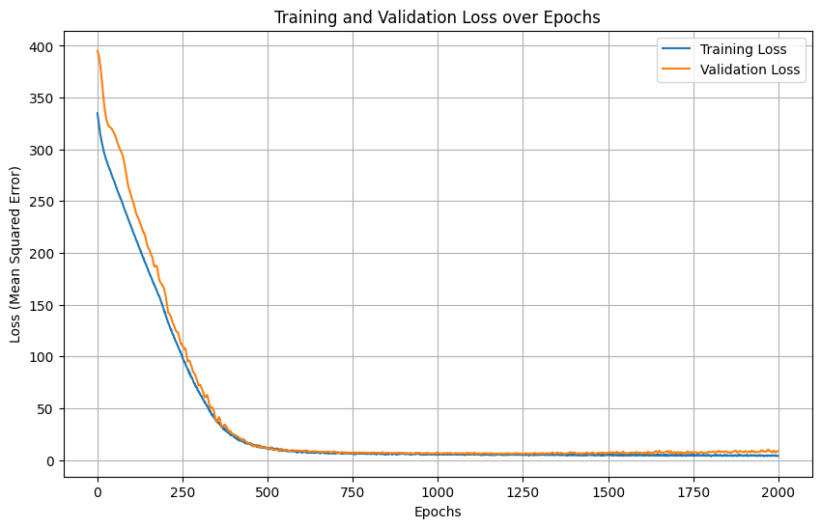
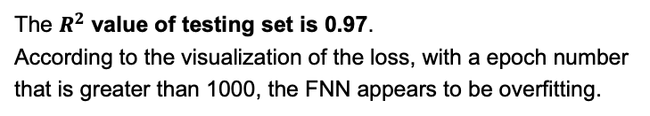
Feedforward Neural Network
A 4-layer architecture incorporates both batch normalization and dropout, with ReLU as activated function
Hyperparameter Tuning
01
'batch_size': 128,
'lr': 0.001,
'module__dropout_rate': 0.2,
'module__hidden_dim1': 256,
'module__hidden_dim2': 128,
'module__hidden_dim3': 16,
'optimizer': optim.Adam
02
Testing Result
03
Conclusion
The model showed a positive learning curve, evidenced by declining loss and MSE values and an increasing R-squared value.
However, more carefully designed FNN structure might lead to a better result.
Notes:
In the end, we trained a feedforward neural network with a 4-layer architecture that incorporates both batch normalization and dropout, using ReLU as the activation function. We tuned the hyperparameters using three-fold cross-validation.
The model achieved an R² of 0.97 on the testing set.
The feedforward neural network shows a positive learning curve, with declining loss and MSE values and an increasing R² value. However, with an epoch number greater than 1000, the model appears to be overfitting.

Slide 18
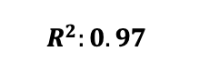
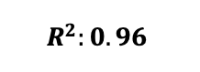
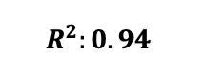
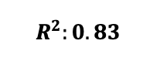
Evaluating the Performance of Models
/06
FNN
Random Forest
By carefully tuning the hyperparameters of a 4-layer FNN, it appears to be the most predictive model.
AdaBoost
The model effectively handles complex, non-linear h-index datasets, pointing out the importance of total citations in predicting h-index
AdaBoost excels in handling datasets with mixed variable types and complex patterns, effectively managing features from different datasets
Linear Regression
Linear Regression's assumption of linearity limits its ability to capture these complex interactions, leading to suboptimal performance.
Notes:
It turns out that widely adopted technique of linear regression is the worst performer of all for this task of predicting H-index. This is a significant finding as the topic of our choice is highly controversial for some people, and in order to avoid any potential mistakes, from the ethical standpoint, we should make sure that we use the best model of all, despite some additional computational requirement, to ensure that our findings are as reliable as we could have made them. So, in this case, using random forests and FFNN is the most rational decision. We would not recommend using adaboost for this specific problem as longer computation time due to the sequential nature of this model doesn’t result in any gain of accuracy over other, less time-consuming methods such as FFNN and Random forests.

Slide 19

Message to the Stakeholders
Main Takeaways From Our H-index Analysis
Importance of Each Feature
Gender Bias in HCI Research
The findings confirm that the H-index is heavily dependent on the total citation count, underscoring the importance of sustained academic contributions over time. While the influence of institutional prestige and recent citations exists, their impact is minimal.
By examining both feature coefficient and the experiment result, we found there is no major difference in research impact of researchers with different genders, indicating almost negligible gender bias in HCI domain.
Notes:
So, to conclude, we discovered that the chosen features for this problem yield some very sensible predictions about H-index. We confirmed that Citation count is indeed one of the most important factors in determining the researchers success, while features like university ranking did not show much of the influence over the H-index, indicating that researcher, if they are onto a great research, will be able to success regardless of the name of the institute that they are working at.

Slide 20

Gender Bias Experiment
To assess gender's impact on academic influence, we modified the gender attribute in our testing dataset and recalculated the H-index using pretrained models.
The consistently high R² values indicate that gender changes do not significantly influence the predicted H-index, suggesting minimal gender bias in HCI research and affirming the H-index objectivity.
Notes:
Most importantly, we examined the gender influence on the H-index prediction, and we concluded that our models do not distinguish between whether a researcher is male or a female, indicating that the true success of the researchers is due to their creativity and drive for the research, and not due to their gender.
As such, we now can conclude with a very high certainty that the field of Human computer interaction is well represented in terms of male and female researchers, and their respective H-indexes are not dependent on their gender.

Slide 21

Future Research Ideas
Exploring the other scientific fields in the similar way, trying to observe general trends in predictive power of each model, as well as the presence of gender bias in those fields
Developing more robust feature representation of researchers that captures the timeline of their career paths
Trying to run similar experiments on a wider range of different Indexes, making a more robust representation of academic success
Notes:
Moving forward, there are couple of things that other researchers can do based on our work.
In particular, Exploring the other scientific fields in the similar way, trying to observe general trends in predictive power of each model, as well as the presence of gender bias in those fields
The other thing is Developing more robust feature representation of researchers that captures the timeline of their career paths as our current methods do not distinguish any timeline of the researchers evolution from when they were a student to the point where they got the title of professor
Finally, Trying to run similar experiments on a wider range of different Indexes, making a more robust representation of academic success, not just focusing on H-index, but rather on a variety of metrics.

Slide 22
Thank you for Watching!
Deniel Shumeiko & Zed Liu
University of Pennsylvania
Notes:
And with that, we would like to thank you for watching our presentation. We hope that you found our research interesting, engaging, and we wish to whoever is watching it a great, successful career!

